Slide 1




DATA SECURITY & PRIVACY PROJECT
Supervised by :
DR.
Azza A. Ali

Slide 2

TABLE OF CONTENT
01
Introduction
02
Our Tools
Analysis & Results
03
04
Questions

Slide 3


INTRODUCTION
An operating system was required to evaluate penetrations because modern hacking techniques have advanced and improved with the advancement of technology. Kali Linux was made available in 2013. For security-related needs, Kali Linux is the most popular operating system. The operating system Kali Linux, which is based on Ubuntu, was created for penetration testing. The user can test the infiltration of a collection of devices and networks using a set of tools that are included. Three tools, namely John, Nmap, and Nikto, have been examined and applied in this project.

Slide 4





OUR TOOLS
Jhon the riper is an open-source software that combines several cracking programs into one tool that runs both brute force and dictionary attack. Initially released for UNIX-based systems, but it has now been ported to a variety of operating systems by means of a CML (Command Line Interface). This software can crack passwords on a variety of operating systems and can be scripted to execute locally or remotely.
Network Mapper is referred to as Nmap. Nmap in Kali Linux refers to an open-source tool that penetration testers frequently utilize for network discovery and system security assessments. Nmap can be used by users for a variety of tasks, such as network inventory, service availability monitoring and host monitoring.
An exploitable vulnerability on a website can be found using this tool, which is written in the Perl language. It scans and examines websites and web apps, reporting any vulnerabilities that can be exploited to exploit the site. Additionally, it can detect faults with specific version information on more than 200 servers and check for vulnerabilities with outdated version details on 1200 servers.

Slide 5


Slide 6


JOHN THE RIPPER
HASH TYPE
Using "hash-identifier", we Check the hash type for each hash.
TEXT FILE
create a text file and place the hash in it.
CRACK
Crack the hash and get the password using this
command" sudo John-format=RAW-(hash type)
(filename)

Slide 7
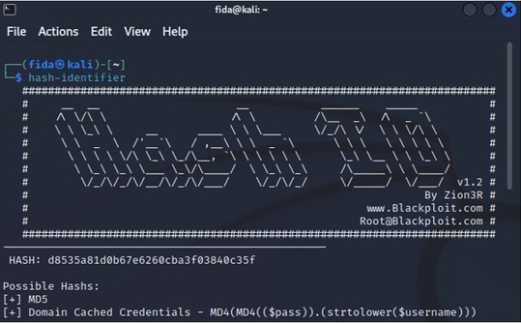
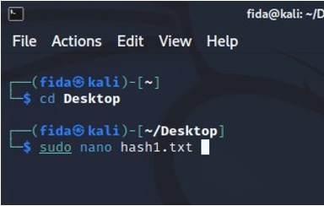
JOHN THE RIPPER
HASH TYPE
TEXT FILE
Using "hash-identifier", we Check the hash type for each hash.
Ceate a text file and place the hash in it.

Slide 8
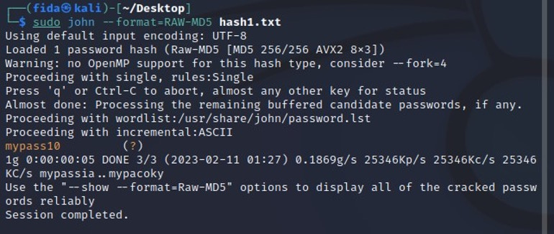
JOHN THE RIPPER
CRACK THE HASH
Crack the hash and get the password using this
command" sudo John-format=RAW-(hash type)
(filename)

Slide 9
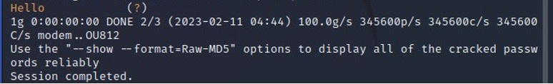
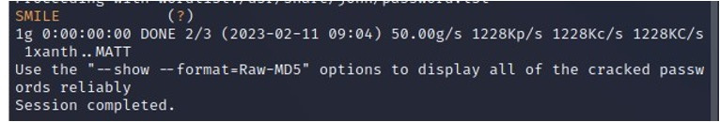
ANALYSIS

Slide 11
NETWORK MAPPER
OPEN NMAP
You will find the Nmap tool under the section for information gathering
IP ADDRESS
Determine the network's IP address, then determine how many devices are connected to it and show more details about these
GATHERING
We use this command to see more details about devices that connect to the network and ports (nmap 172.20.10.4

Slide 12
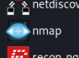
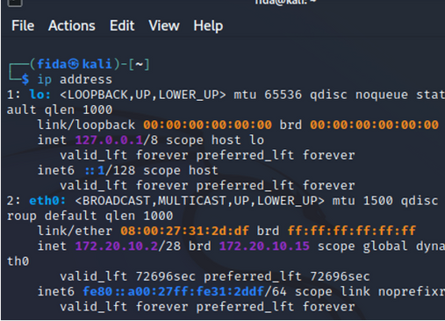

NETWORK MAPPER
OPEN NMAP
IP ADDRESS
You will find the Nmap tool under the section for information gathering
Determine the network's IP address, then determine how many devices are connected to it and show more details about these

Slide 13
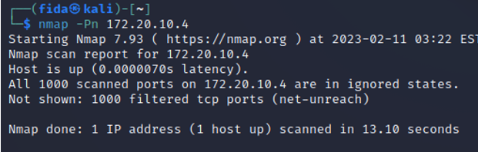
NETWORK MAPPER
GATHER INFORMATION
We use this command to see more details about devices that connect to the network and ports (nmap 172.20.10.4)

Slide 14
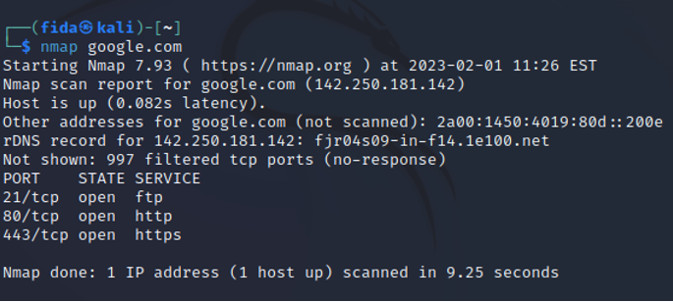
ANALYSIS

Slide 16
NIKTO
OPEN NIKTO
You will find the NIKTO tool under the section for vulnerability Analysis
NIKTO -H
VULNERABILITY SCANNING
When we learn about any new tool, we will explore all the commands that are available to the user. Through the NIKTO -h command, it will display all the commands that can be used, with a simple explanation of each command.
vulnerability scanning against web servers for multiple items including dangerous files and programs, and checks for outdated versions of web server software.

Slide 17
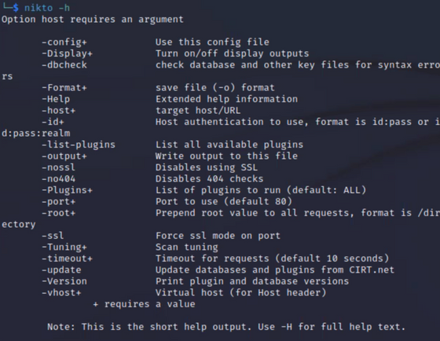
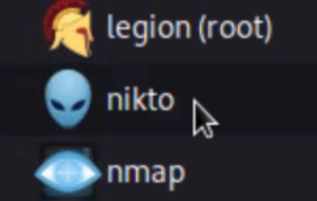
NIKTO
OPEN NIKTO
NIKTO -H
You will find the NIKTO tool under the section for vulnerability Analysis
When we learn about any new tool, we will explore all the commands that are available to the user. Through the NIKTO -h command, it will display all the commands that can be used, with a simple explanation of each command.

Slide 18
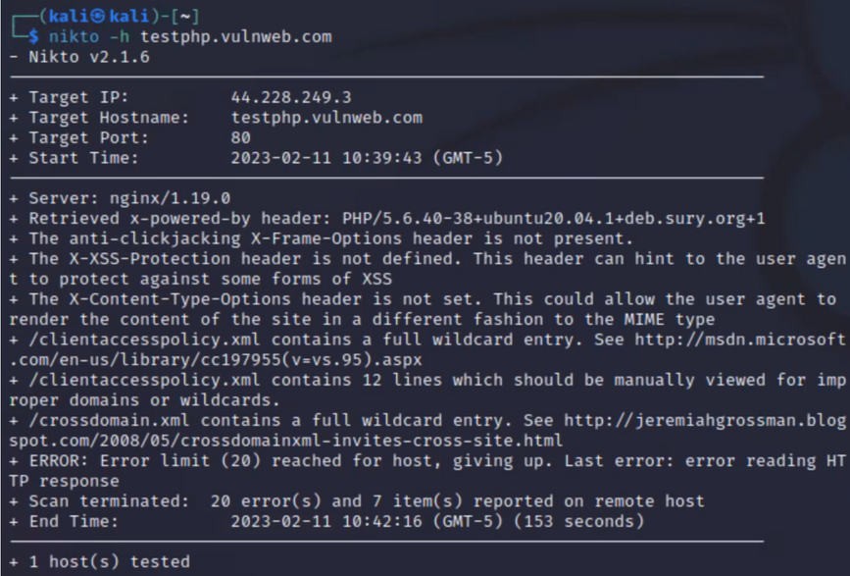
NIKTO
VULNERABILITY SCANNING
In this step, the vulnerabilities encountered by testphp.vulnweb.com will be tested using the command. By using this command:(nikto -h <IP or hostname>).

Slide 19
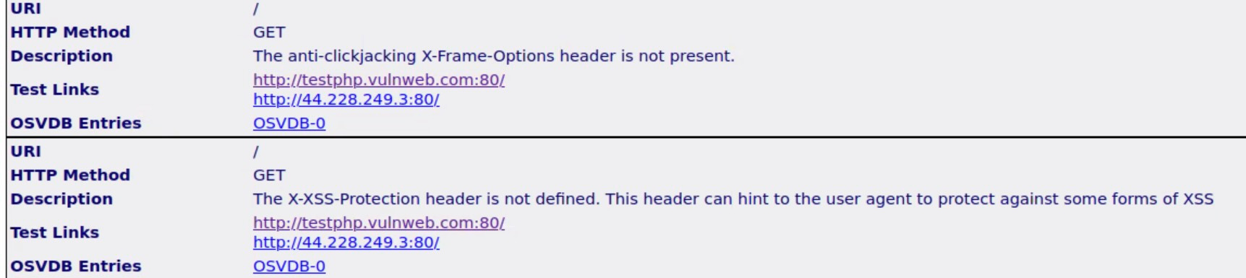
ANALYSIS

Slide 20
Thanks!
Do you have questions?

